Slide 1
Suicides Rate Prediction in India
Group Members:
Anmol Koul(33203)
Prasad Gawade(33225)
Bhagyashree Karnavat(33235)
Shreyash Khandait(33237)

Slide 2
Introduction:
The suicide rate in India is 10.3. In the last three decades, the suicide rate has increased by 43% but the male female ratio has been stable at 1.4 :
Majority (71%) of suicide in India are by persons below the age of 44 years which imposes a huge social, emotional and economic burden. Fifty four articles on suicides have been published in IJP(Indian Journal of Pediatrics).
Several studies reveal that suicidal behaviours are much more prevalent than what is of officially reported. Poisoning, hanging and self immolation (particularly women) were the methods to commit suicide. Physical and mental illness, disturbed interpersonal relationships and economic difficulties were the major reasons for suicide.
The vulnerable population was found to be women, students, farmers etc. A social and public health response in addition to a mental health response is crucial to prevent suicidal behaviour in India.

Slide 3
Objective:
In this mini-project we wanted to develop an efficient system that analyses the data given from the dataset. The main objective of the project is to make a detailed analyses of suicide rate by studying the graphical interface and draw a conclusion about what age group, which area, what are the main causes that really causes suicides in India .

Slide 4
Dataset Description:
“Suicide in India 2020-2021.csv” this dataset can be used for analysis of suicides that took place in India during the time period of 2001-2012 .
Context:
This data set contains yearly suicide detail of all the states of India by various parameters from 2001 to 2012. Content Time Period: 2001 - 2012 Granularity: Yearly Location: States of India.
Parameters: a) Suicide causes b) Education status c) By means adopted d) Professional profile e) Social status
Columns:
1. State
2. Year
3. Type_code
4. Type
5. Gender
6. Age_Group
7. Total

Slide 5
Steps Involved in Analysis:
1.Importing Libraries and Dataset:
Libraries imported are pandas, NumPy, matplotlib, seaborn, warnings, os.
2.Pre-Processing the data available:
Checked for missing values in the dataset and resolved it.
3. Visualization and Analysis:
1. Suicide rate over years.
2. Gender wise suicide frequency
3. Educational background vs Total Suicides vs Gender
4. Causes of suicide vs total suicides vs Gender
5. Professional Status vs Total suicides vs Gender
6. Suicides due to Addiction
7. Suicides due to family problems

Slide 6
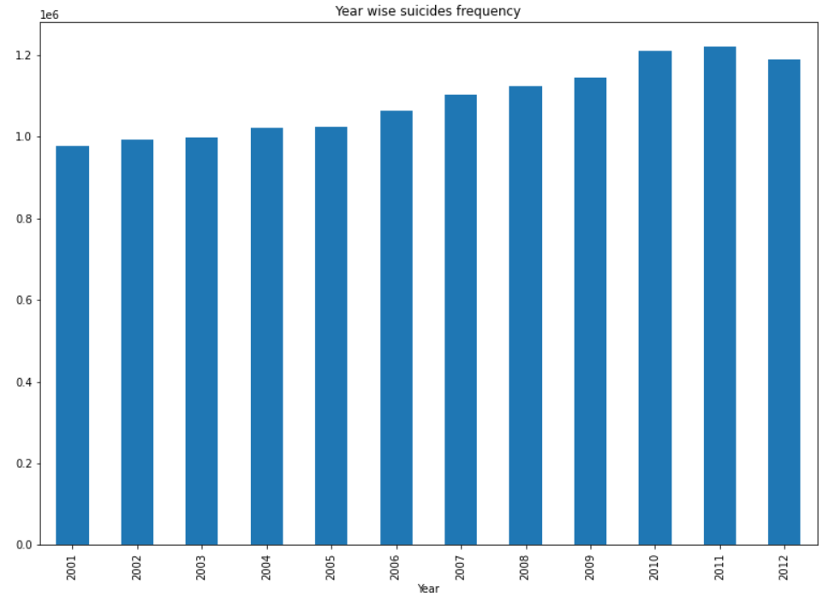
Suicide Rate Over Year(2001-2012)

Slide 7
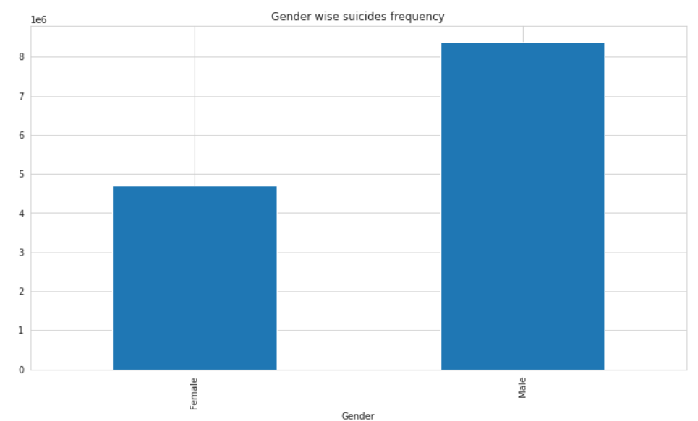
Gender Wise Suicide Frequancy

Slide 8
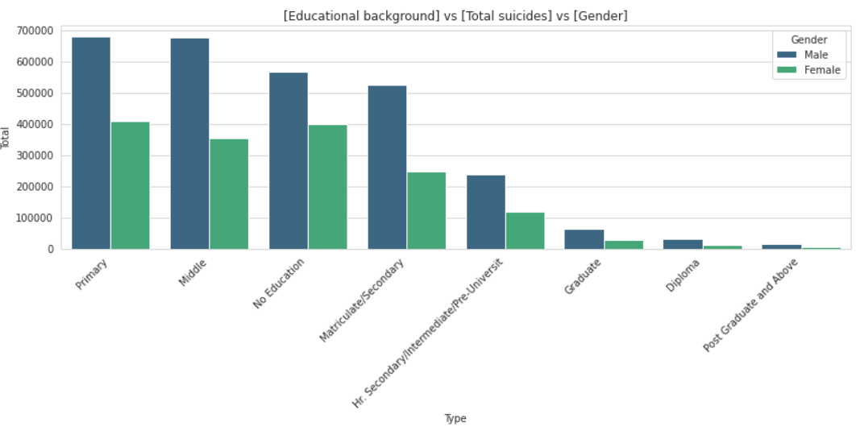
Educational background VS Total Suicide

Slide 9
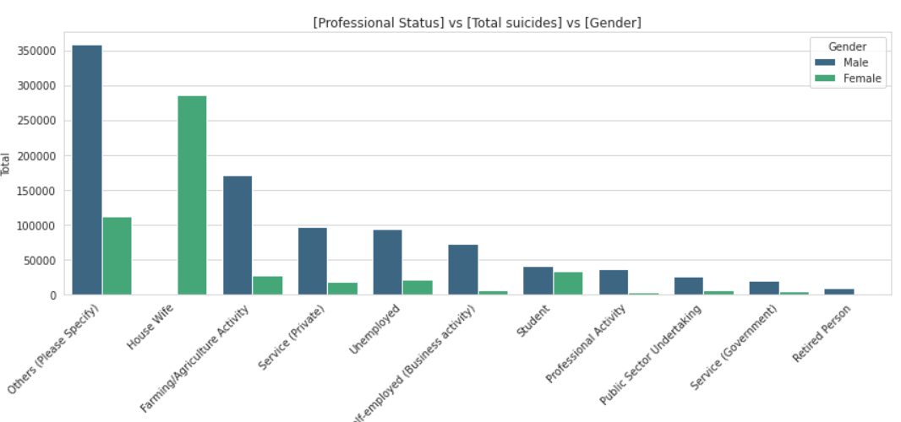
Professional Status VS Total Suicide

Slide 10
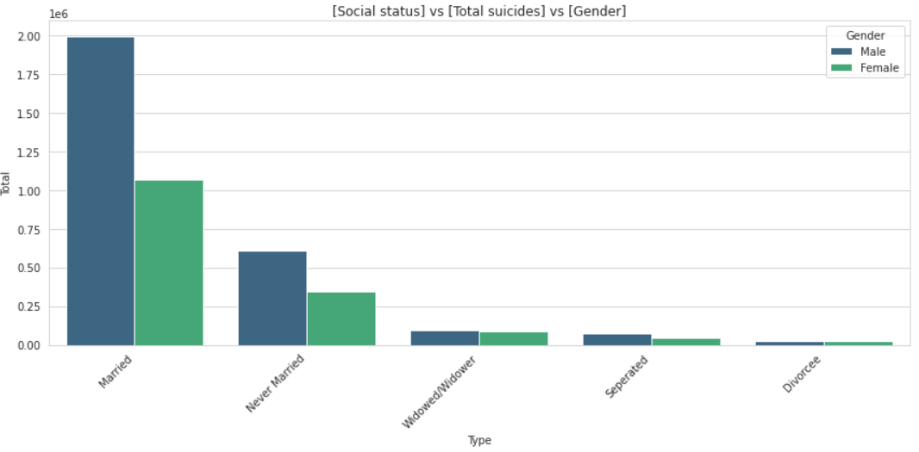
Social Status VS Total Suicide

Slide 11
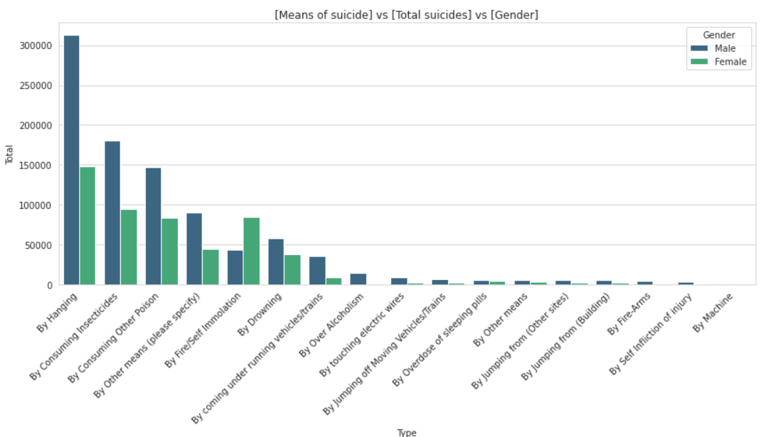
Means of Suicide VS Total Suicide

Slide 12
Conclusion:
As per observation of above graphs :
1. Age group between 15-44 has the highest number of suicides.
2. Maharashtra, West Bengal and Tamil Nadu have the highest suicide rate this might also be because of the high population in these states.
3. Family Problems, Illness, Mental Illness are some of the main reason while most of the reasons are still unknown.
4. Hanging, Consuming Insecticides is more common but, most of other means are unknown.
5. Most of the professional profile is unknown but house wife comes in second, while Farming comes in at third.
6. The reason for suicide at the age group between 0-14 is because of Failure in Examination.

Slide 13
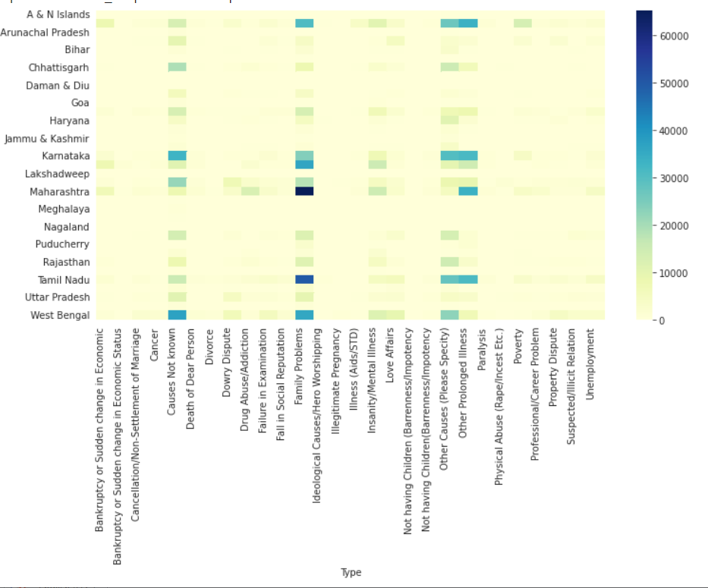
Conclusion

Slide 14
References:
www.kaggle.com
www.researchgate.com
www.upgrad.com

